Slide 1
Teaching Big Data and Open Source Software
Gregor von Laszewski
laszewski@gmail.com
Indiana University
Intelligent Systems Engineering Department

Slide 2
Abstract
Over the last several years we have implemented at Indiana University a set of courses to educate students about big data. The lectures are coordinated to teach the students different aspects ranging from analytics, software for big data and infrastructure management with DevOps. The classes are project oriented classes and allow the students to integrate their own interests into the learning experience increasing the enthusiasm for the classes. The classes are combined taught online and in residential fashion bringing unique challenges in managing the classes. Resources used in the class contain our own clouds, SDSC Comet, Jetstream, and Chameleon cloud. Due to the size of the class management of allocations and students is essential.

Slide 3
Acknowledgement
This study has been conducted as part of the I524 class with the topic Big Data and Software Projects
The class used the following resources
Students computers
FutureSystems (DSC @ Indiana University) a continuation of the FutureGrid (NSF)
Chameleon Cloud (NSF): Project CH-818664, KVM
Jetstream (NSF)
Comet (NSF)
Some students also elected to use
AWS
Azure
All resources as far as we know were provided to us for free.
Big Data Reference Architecture from NIST

Slide 4
Hours used
I524 course had 62 registered users and used 91% of its allocation with 18195 SUs. From 31 projects, 27 of them were completed while the other 4 are still being worked on. As the chameleon cloud allocation for this project expired on July 31, we will have to renew (over vacation).
In addition to Chameleon cloud, we also used Jetstream and the FutureSystems cloud. Adding these clouds was essential to obtain comparisons of chameleon cloud to other clouds.
I523 has 80 students

Slide 5
Technology Trends
Gregor von Laszewski
laszewski@gmail.com

Slide 6
Big Data … … where and what is it ?
Often we may not see it because its hidden in lots of data
Often we can not see it as the data is noisy
Often we can not see it as the data is unimportant
Often we can not see it as we have no time to find it
Often we can not see it as the data is uninteresting

Slide 7
2015
Where is Big Data?
Gartner Technology hype cycle
The hype cycle is a branded graphical presentation developed and used by the American research, advisory and information technology firm Gartner, for representing the maturity, adoption and social application of specific technologies.
https://en.wikipedia.org/wiki/Hype_cycle
hype cycle

Slide 8
2016
Where is Big Data

Slide 9
2017
Where is big data?
http://www.gartner.com/smarterwithgartner/top-trends-in-the-gartner-hype-cycle-for-emerging-technologies-2017/

Slide 10
Data Never Sleeps 3.0
Source: https://www.domo.com/blog/data-never-sleeps-3-0/
2015

Slide 11
Data Never Sleeps 4.0
https://www.domo.com/blog/data-never-sleeps-4-0/
2017

Slide 12
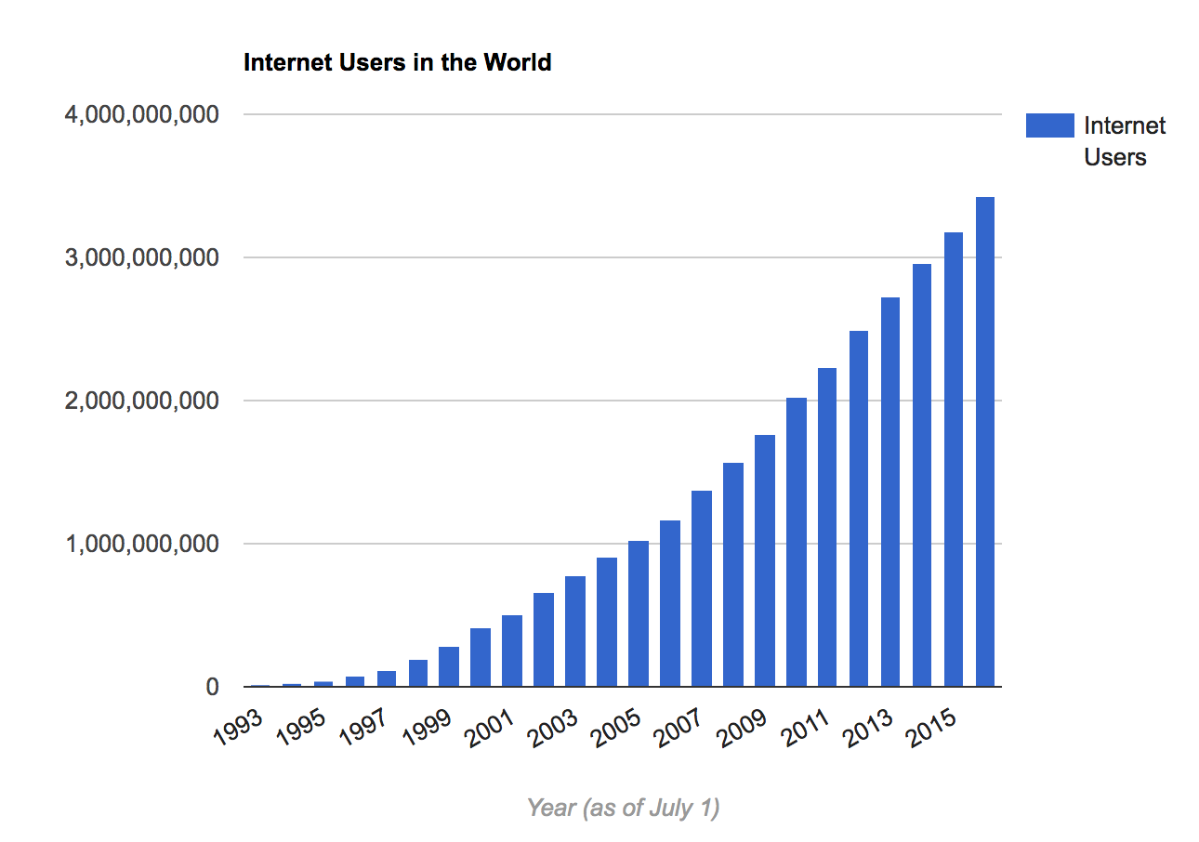
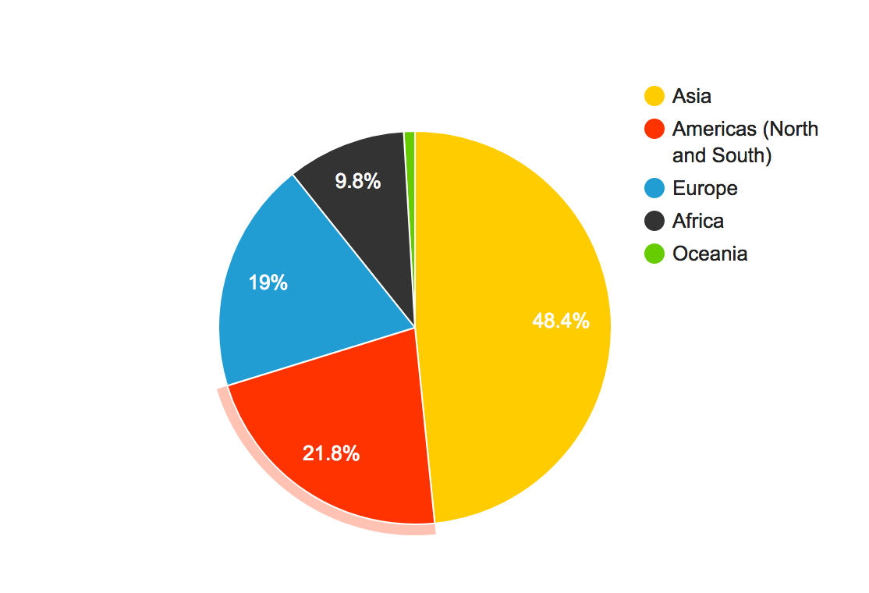
Internet Population -> Future Data

Slide 13
Internet vs World Population -> Future Data

Slide 14
Machine Inteligence 3.0
I creased focus
Better results
Better Hardware
Desktop Supercomputing

Slide 16
Big Data … … where and what is it?
Not only do we have big data, but the big data ecosystem is vast and complex,

Slide 17
How do we teach big data …
?
Attend classes at IU ;-)

Slide 18
Data Scientist
i523
(i524)
Analysis
Programming
Visualization
Domain Knowledge
Communication
Statistics
Machine Learning
Python, JavaScript
Distributed Comp.
Basic Skills
Customize for Data Set
Paper write-up
Infrastructure
Cloud Computing
Distributed Systems
Cloud Programming
Online Publication
DevOps
Optimization
i523
I524
iCloud
i523
i524
Requires integrated knowledge in several key areas. We use a project that addresses:
Communication
Analysis
Visualization
Programming
Infrastructure
Domain knowledge
Education Programs need to address all of them
There are many more classes
Data Scientist
I524
iCloud
(i523)
(i523)
(i524)

Slide 19
Long Way to being a Data Scientist
There may be different pathways not depicted here
This is just an example
https://cdn.datafloq.com/cms/2015/10/26/long-road-to-data-scientist.png?utm_source=datafloq&utm_medium=ref&utm_campaign=datafloq

Slide 20
High Performance Computing Enhanced Apache Big Data Stack
Diagram: Fox at al. http://hpc-abds.org/kaleidoscope/
von Laszewski, Fox at al.: Textual collection of 399 selected tools, services, and frameworks https://cloudmesh.github.io/classes/i524/2017/technologies.html
Bibliography included: https://github.com/cloudmesh/classes/blob/master/docs/source/refs.bib
Documents:
https://github.com/cloudmesh/sp17-i524/raw/master/paper2/proceedings.pdf
https://github.com/cloudmesh/sp17-i524/raw/master/paper2/proceedings.pdf
http://hpc-abds.org/kaleidoscope/

Slide 21
Course Workflow

Slide 22
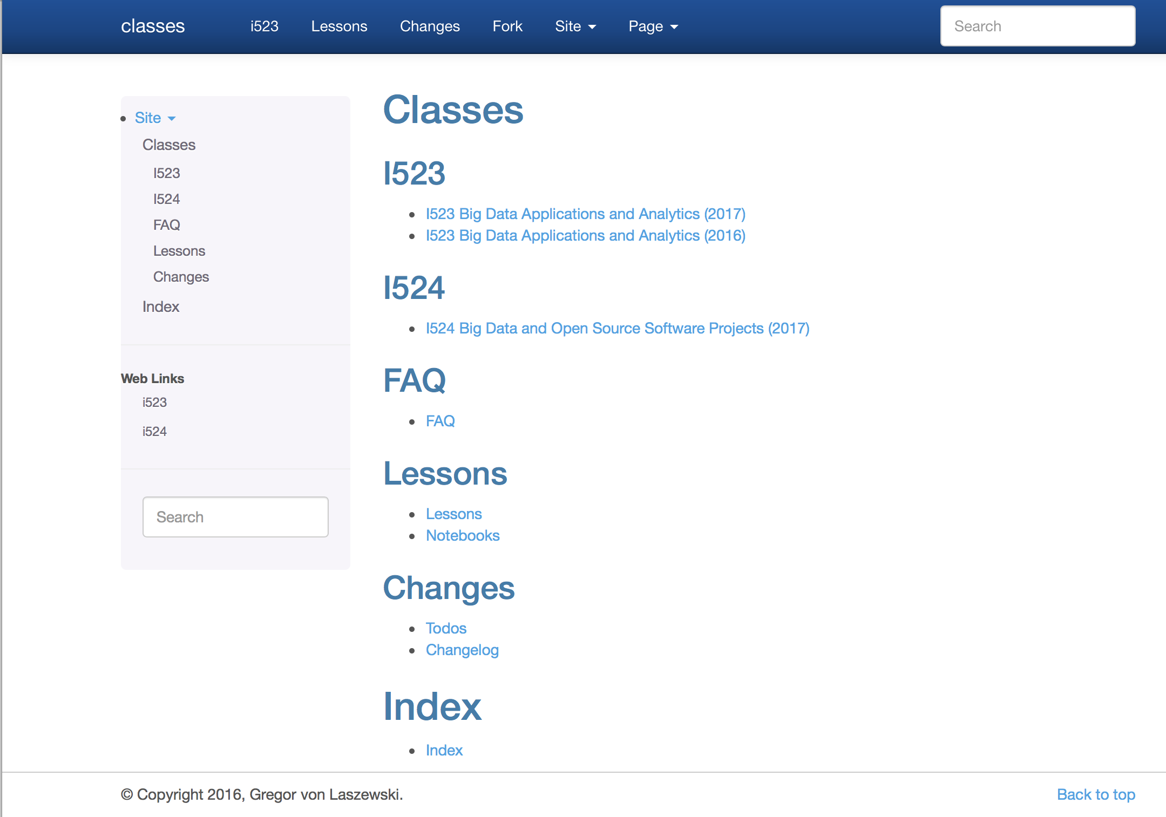
Cloudmesh classes
Class material on github

Slide 23
I523 Theory Track
3.1. Introduction
3.2. Overview of Data Science
3.3. Big Data Use Cases Survey
3.4. Health Informatics Case Study
3.5. e-Commerce and LifeStyle Case Study
3.6. Physics Case Study
3.7. Radar Case Study
3.8. Sensors Case Study
3.9. Sports Case Study
3.10. Web Search and Text Mining

Slide 24
I524 Theory
TechnologiesWorkflow-Orchestration
Application and Analytics
Application Hosting Frameworks
High level Programming
Streams
Basic Programming model and runtime, SPMD, MapReduce
Inter process communication Collectives
In-memory databases/caches
Object-relational mapping
Extraction Tools
SQL(NewSQL)
NoSQL
File management
Data Transport
Cluster Resource Management
File systems
Interoperability
DevOps
IaaS Management from HPC to hypervisors
Cross-Cutting Functions
Monitoring
Security & Privacy
Distributed Coordination
Message and Data Protocols
360+ Software systems
Organized by Big Data related topics
The cloud computing architecture
underlying open source big data software and frameworks that contrast them to high performance computing.
Analysis of software
as part of an architecture with its different layers covering broad functionality and rationale for each layer.
Replicated
software environments combining cloud and DevOps technologies.
Cloudmesh client
Project oriented

Slide 25
Changing The Classes to Allow Experimentation
Old
New
Define small homework
Have all small homework graded
Disadvantage:
No experimentation possible
Problems may not be targeting large project
Advantage:
Quick feedback on how they do
Suited for large MOOCs
Class is project oriented
All homework prepare for the project
Disadvantage:
Fewer graded homework
More difficult to grade
Suggested: for each 20 students one TA
Advantage:
Allows for experimentation
Allows flexibility
Allows student to integrate own ideas

Slide 26
Changing The Classes to Allow Openly Sharing (for reasonable class sizes I523, I524)
old
new
Students do the same assignment/report/project
Advantage:
Grading easier
Disadvantage
We do not learn how to share
High degree of plagiarism possible
Students do different assignment/report/project
Group work encouraged
Advantage:
Students can integrate interests
Diverse set of results as outcome of class
Fewer graded homework
Disadvantage:
Assignment complex to distinguish each assignment
Management of grading complex
Homework more complex

Slide 27
Resources
FutureSystems
Chameleon
Jetstream
(Cybera)
Virtual Cluster
Vagrant
Slurm
Container Cloud
Azure
Amazon
OpenStack
SSH
FutureSystems
Comet
Cloudmesh allows to access a variety of resources easily
Used for class
Cloudmesh
Comet

Slide 28
Teaching Cloud Collaboration & Resource Tools
System
SSH: Managing keys, config, tunnel
OpenStack: via cloudmesh
Package Managers: yum, apt-get, and brew
DevOps: Ansible (.e.g. python)
Programming
Editors: pycharm, emacs
Python
pyenv, virtualenv, pypi
numpy, scipy, matplotlib, …
Piazza
Zoom
Github
Google Tools
Google hangout
Remote desktop

Slide 29
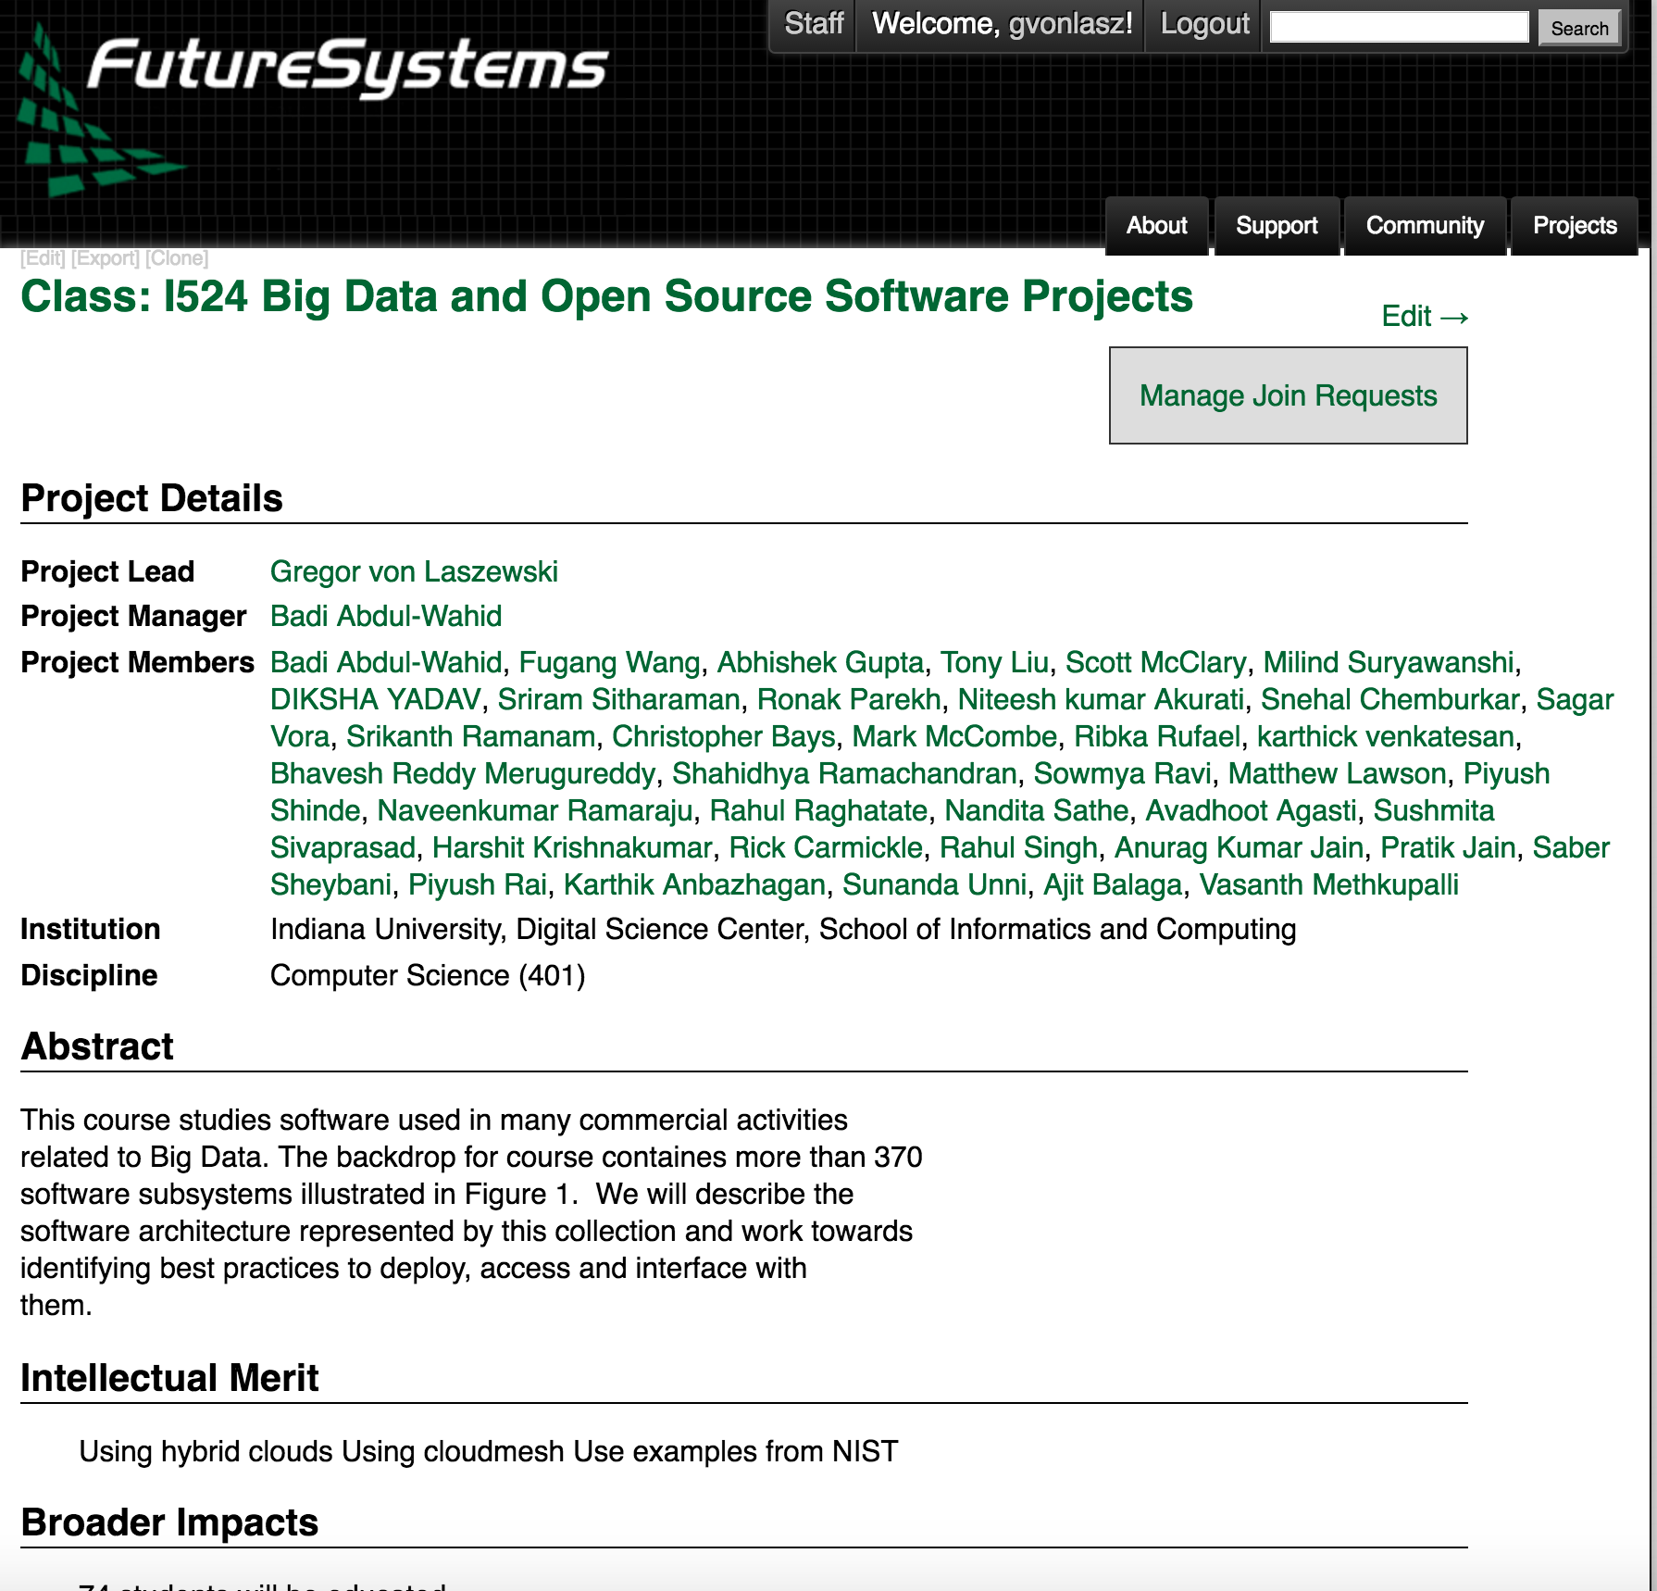
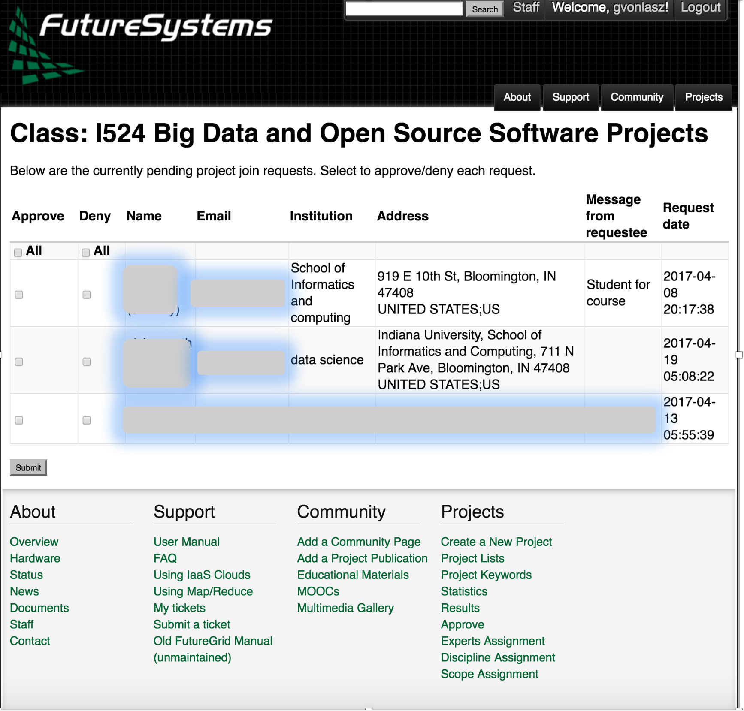
Superior FutureSystems User Management

Slide 30
Cloudmesh High Level Architecture
Abstraction essential to Cloudmesh design
Abstractions at different levels and interaction points
IaaS
Container
HPC
PaaS
Virtual Cluster
Integration with Providers
IU OpenStack, NSF Chameleon cloud, NSF Comet, AWS, Azure, SLURM/XSEDE, …
Used by hundreds of users

Slide 31
Cloudmesh Layered Architecture
Easy extensibility
Developed with command shell in mind
Developed with REST in mind
Horizontal Integration
Access – Data – Compute
Vertical Integration
`Security - Choreography

Slide 32
Cloudmesh Deployment Abstractions
Possible interaction with different DevOps frameworks
Leveraging large DevOps community
Warning we found that there are many DevOps “templates” but not all of them are usable:
lack generality
do not work
too complex
not properly documented

Slide 33
Continuous Improvement vs. Continuous Deployment via DevOps
DevOps is integrated
Leads to improvement when not only targeting application but also deployment environment.

Slide 34
Cloudmesh Shell – Make Booting Simple
$ emacs cloudmesh.yaml
$ cms default cloud=CLOUD
$ cms default image=IMAGE
$ cmd default flavor=FLAVOR
$ cms vm boot
$ cms vm login
$ cms vm delete
Prepare defaults
Boot
Login
Management
cloudmesh.yaml
…

Slide 35
Cloudmesh Shell – Manage Hybrid Clouds
$ cms aws boot
$ cms vm boot
$ cms default cloud=chameleon
$ cms vm boot
$ cms default cloud=IUCloud
$ cms vm boot
Boot Cloud B
Boot Cloud A
Boot Cloud C

Slide 36
Cloudmesh Shell – Create a Hadoop Cluster
$ cms default cloud=chameleon
$ cms cluster define - -count=10
- -flavor=m1.large
$ cms hadoop define spark
$ cms hadoop sync # ~30 sec
$ cms hadoop deploy # ~ 7 min
Define cluster
Define hadoop Cluster
Set cloud
Deploy the cluster
Sync definition to db

Slide 37
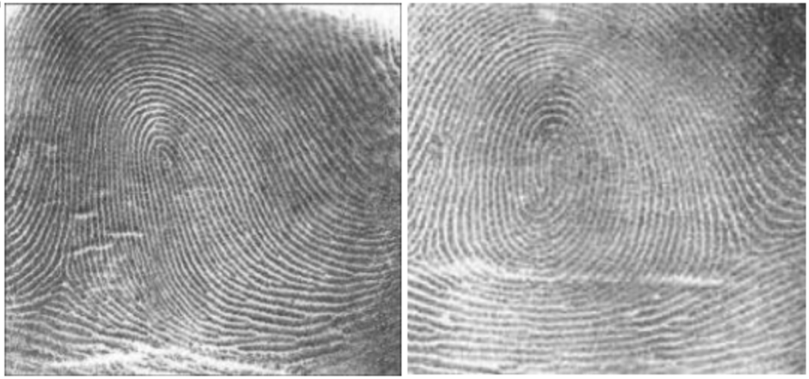
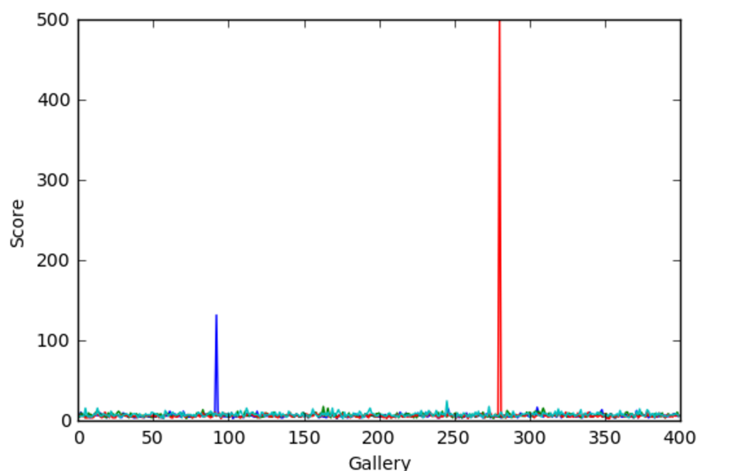
Cloudmesh Shell – Create a Hadoop Cluster
$ cms default cloud=IUCloud
$ cms cluster define - -count=10
- -flavor=m1.large
$ cms nist fingerprint # ~ 30 min
Define cluster
Set cloud
Run NIST usecase
Additional resources:
https://github.com/cloudmesh/classes/blob/master/docs/source/notebooks/fingerprint_matching.ipynb

Slide 38
Shell
$ cms
cms>
cms> help
help COMMANDNAME

Slide 39
Adding new commands is simple
$ cms sys command generate BarCommand
from __future__ import print_function
from cloudmesh.shell.command import command
from cloudmesh.shell.command import PluginCommand
class BarCommand(PluginCommand):
@command
def do_bar(self, args, arguments):
… example with manual page documentation …
$ python setup.py install; pip install .
$ cms bar help
""" :: Usage:
command -f FILE
command FILE
command list …..

Slide 40
Integration of Research Into the Class
Provide students the option to work on state-of-the-art research project
Research project must be introduced early on
Not every student may want to contribute
Encourage motivated students to integrate the research into their project
Present in Class
Research Project
Prepare for Class Inclusion
Review Completed Project
Integrate in Project
Integrate Into Research

Slide 41
NIST Big Data Public Working Group
NIST Big Data Interface
Volume 8
Gregor von Laszewski, lasewski@gmail.com
https://laszewski.github.io/papers/NIST.SP.1500-8-draft.pdf

Slide 42
Volume 8 –Opportunities for Contribution
Volume 8 is in draft stage.
We look for additional contributors to the volume 8
We want to keep the initial part of the draft as simple as possible and develop contributions based on ASCII text modifications.
Contributions can be conducted in multiple ways
A) Make modifications to the PDF document with PDF augmentation tools such as Adobe or Skim, send via e-mail.
B) Make modifications in ASCII while specifying the section you like to modify (section header, new paragraph, line numbers), send via e-mail.
C) Make modifications through git pull requests

Slide 43
Presentation Overview
Volume Presentation Outline
Volume 1, Definitions
Volume 2, Taxonomy
Volume 3, Use Cases
Volume 6, Big Data Reference Architecture
Volume 4, Big Data Security and Privacy
Volume 8, Reference Architecture Interface
Reference Architecture Software Implementation Environment and Demonstration
Volume 7, Standards Roadmap
Volume 9, Adoption and Modernization

Slide 44
Current Working Group Influences
Interfaces
Use Cases
Vol 3
Architecture
Vol 8
Security & Privacy
Vol 3
Definitions Vol 1
Taxonomy Vol 2
Cloudmesh
& Cloudmesh Comet
Working Group Volumes
Cloudmesh
Cloudmesh Comet @ SDSC/IU

Slide 45
Document Structure
1
Interface Requirements
3
Specification Paradigm
4
Specifications
Introduction
2
Appendix
A
4.1
Data
4.3
Virtual Cluster
4.4
IaaS
Identity
4.2
Compute Services
4.5
Containers
4.6
Others to be added
4.7
Deployment
4.8
Map Reduce
4.9
Microservices

Slide 46
Volume 6: NIST Big Data Reference Architecture
INFORMATION VALUE CHAIN
Management Fabric
Security and Privacy Fabric
System Orchestrator
Big Data Application
DATA
Preparation/ Curation
Analytics
Visualization
DATA
Data Provider
Data Consumer
SW
Collection
Access
SW
DATA
SW
Big Data Framework Provider
IT VALUE CHAIN
Processing: Computing and Analytic
Batch
Interactive
Streaming
Platforms: Data Organization and Distribution
Messaging/Communications
Indexed Storage
Resource Management
File Systems
Infrastructures: Networking, Computing, Storage
Virtual Resources
Physical Resources
K E Y :
DATA
Big Data Information Flow
Service Use
SW
Software Tools and Algorithms Transfer

Slide 47
Volume 8 – Document Scope
Established operational interfaces
for management interactions and dataflow with needed resources between NBDRA components
Described and defined specific interfaces and the interactions
between NBDRA components
Developed a set of interfaces defined through examples
that can be used to create schema based definitions of objects that are manipulated through Big Data design patterns

Slide 48
Volume 8 – Possible Version 3 Topics
Formalization of the interfaces defined by example
Validate the interfaces
Verifying select use cases
Working with domain experts
to identify workflow and interactions among the NBDRA components and fabrics
Exploring and modeling interactions
within a small-scale, manageable, and well-defined confined environment
Aggregating the common data workflow and interactions
between NBDRA components and fabrics and package them into general interfaces.

Slide 49
Reference Architecture Software Implementation Environment and Demonstration
Cloudmesh provides a first reference implementation
Features include IaaS, Hadoop, and software stack deployment.
It was tested based on Application from Use Case document.
Code is hosted in github and is available.
Focus on Cloudmesh command shell and REST service as it is
Scriptable
Interpretable into other frameworks
Accessible through other frameworks via REST.
Disclaimer: we move from our original cm implementation to cms to distinguish the two efforts. The new implementation can use the NIST specification and generates a REST service automatically.

Slide 50
Simple Interface Usecase: Boot a vm on

Slide 51
Simple Interface Usecase: Boot & Provision

Slide 52
Phase 1: Interface Objects

Slide 53
Specification -> Reference implementation
1. Github
2. Specifications
3. Document Source
4. PDF
Semi-Automated Process
(Review is not automated, integration with NIST publication framework)
1. Specification
2. Cloudmesh schema
3. Schema
4. Rest Service
Vol 8. Specification
Cloudmesh schema generates …
… a valid schema from the specification
The schema is used to automatically generate a REST service

Slide 54
Design by example
{
"profile": {
"description": "The Profile",
"uuid": "jshdjkdh...",
"context:": "resource",
"email": "laszewski@gmail.com",
"firstname": "Gregor",
"lastname": "von Laszewski",
"username": "gregor",
"publickey": "ssh ...."
}
Simple to understand
Encourages discussion
Generation of rest service can be automatized
Types are derived from types of the attributes

Slide 55
Design by example (cont.)
profile = {
’schema’: {
’username’: {’type’: ’string’},
’context:’: {’type’: ’string’},
’description’: {’type’: ’string’},
’firstname’: {’type’: ’string’},
’lastname’: {’type’: ’string’},
’publickey’: {’type’: ’string’},
’email’: {’type’: ’string’},
’uuid’: {’type’: ’string’},
}
}
GET profile - get list
GET profile/12 - get obj.
POST profile - upload
PUT profile/12 - upload
PATCH profile/12 - change
DELETE profile/12 - delete

Slide 56
Reproducibility Use Case Fingerprint: Deployment is complex
Requires
Application knowledge
Deployment/DevOps knowledge
What if application user could do also the deployment?
Use newest software
Use newest hardware
Benchmark different setups

Slide 57
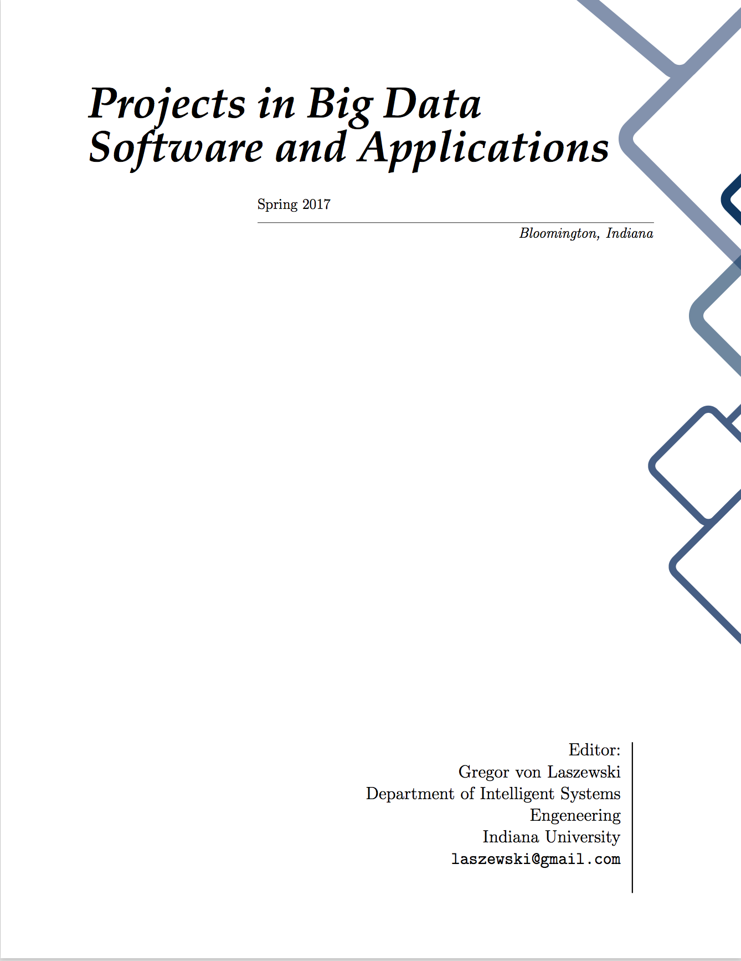
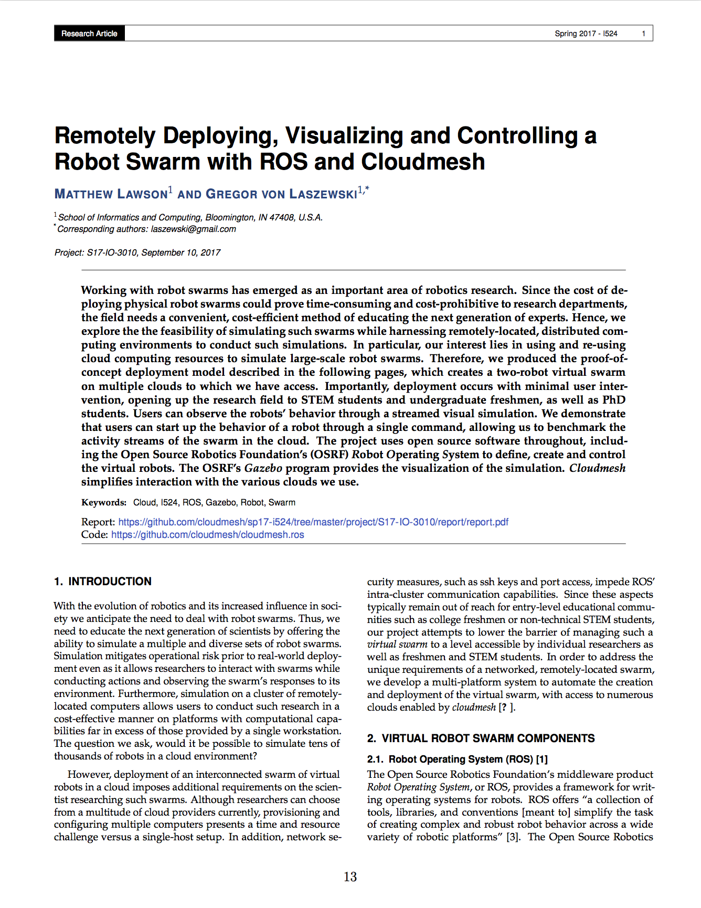
Automated Project Proceedings via Github
https://github.com/cloudmesh/sp17-i524/raw/master/project/projects.pdf
Developed by von Laszewski, Gregor

Slide 58
Projects
Remotely Deploying, Visualizing and Controlling a Robot Swarm with ROS and Cloudmesh
Charge Detection Mass Spectrometry
Automated Sharded MongoDB Deployment and Benchmarking for Big Data Analysis
Music Predictive Analysis Project based on Lyrics
Deploying CouchDB Cluster
Analysis of USGS Earthquake Data
Twitter sentiment xanalysis of the Affordable Care Actin 2017
Detection of street signs in videos in a robot swarm
Analysis of H-1B Temporary Employment-Based in Data Science Occupation
On-line advertisement click prediction
Flight Data Analysis Using Big Data Tools
Real-time Analysis and Visualization of Twitter data
Aviation Data Analysis Using Apache Pig
Detecting Stop Signs in Images and Videos in a Robot Swarm
Using Hadoop and Spark for Big Data Analytics: Predicting Readmission of Diabetic patients
Analysis Of People Relationship Using Word2Vec on Wiki Data
Amazon Web Services Cloudmesh Extension
Deploying a spam message detection application using R over Docker and Kubernetes
Big data Visualization with Apache Zeppelin
Cloudmesh Docker Extension
Deployment of Vehicle Detection application on Chameleon clouds
Head Count Detection Using Apache Mesos
Optical Character Recognition
Weather Data Analysis
Analysis of Airline delays data using Spark and HDFS
Deployment and performance analysis of a Storm cluster on various cloud environments
Predicting Customer Churn Using Apache Spark Machine Learning

Slide 59
Conclusion
Multiple Classes to support Big Data education
Integrated comprehensive covering of the many topics
Access to cloud resources
Change in class structure
From: Small assignments
To: Project oriented class
Do everything open source if possible
Create a class proceedings
Links:
https://github.com/cloudmesh/sp17-i524

